Slide 1


Image Segmentation
Sanjay Jaras
Bellevue University

Slide 2
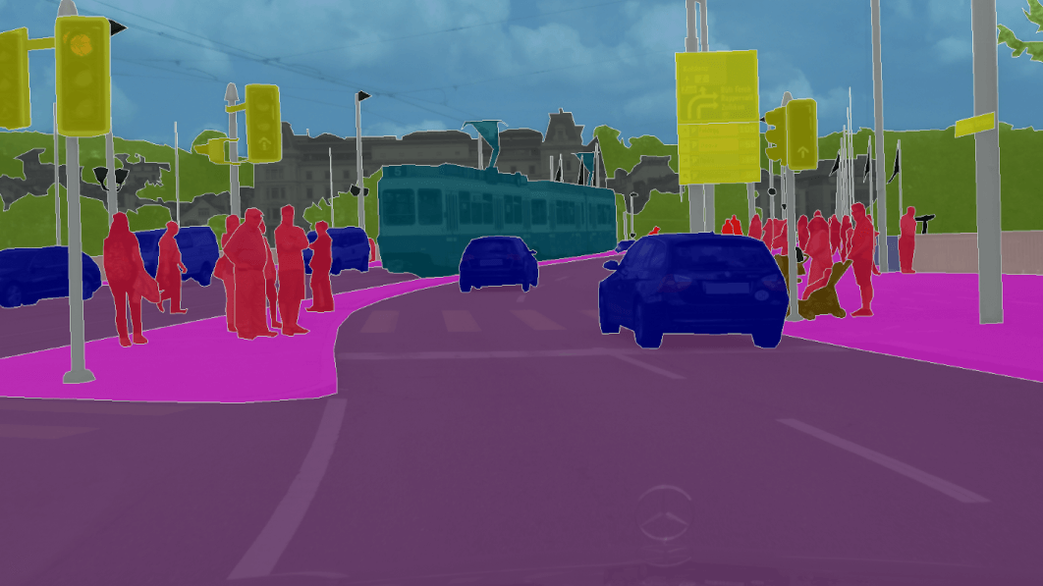
Introduction and Problem statement
What is Image Segmentation?
Applications of Image Segmentations

Slide 3
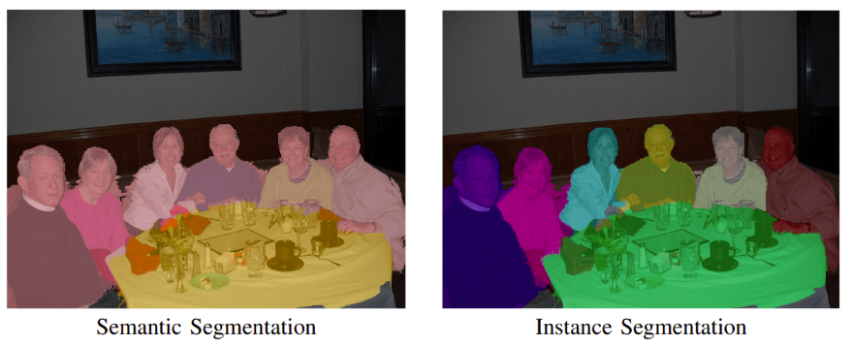
Types of Segmentation
https://neptune.ai/blog/image-segmentation-in-2020

Slide 4
Image Segmentation Architectures
U-Net
FastFCN —Fast Fully-connected network
Gated-SCNN
DeepLab
Mask R-CNN

Slide 5
Step Performed
Data Understanding
Data cleaning and preparation
Model compilation
Model Training
Testing model

Slide 6
Dataset
Visual Object Classes Challenge 2012 (VOC2012)
1464 training images
1449 validation images
Original Image
Segmentation Mask Image

Slide 7
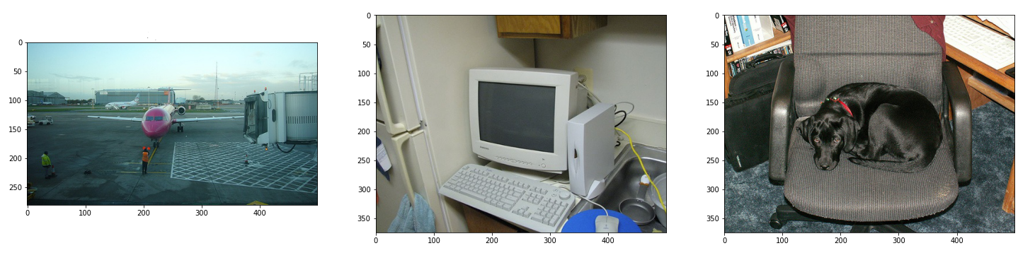
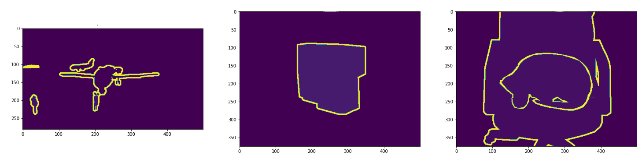
Data Understanding
Input images
Mask Images

Slide 8
Data Understanding
Labels
1 Aeroplane
2 Bicycle
3 Bird
4 Boat
5 Bottle
6 Bus
7 Car
8 Cat
9 Chair
10 Cow
11 Dining table
12 Dog
13 Horse
14 Motorbike,
15 Person
16 Potted plant
17 Sheep
18 Sofa
19 Train
20 Tv/monitor
0 Background
255 Unknown

Slide 9
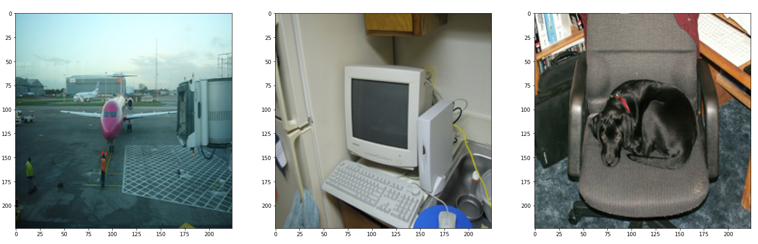
Data Preparation
Image Resizing

Slide 10
Data Preparation
Train, Test, and validation dataset Split
Original Dataset
1464 Training images
1449 Validation images
After Split 2164 Training images 300 Test images
449 Validation images

Slide 11
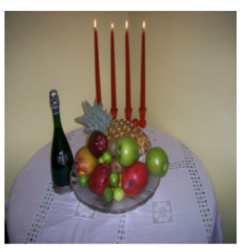
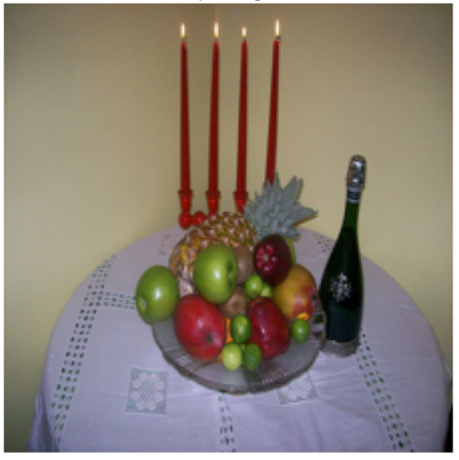
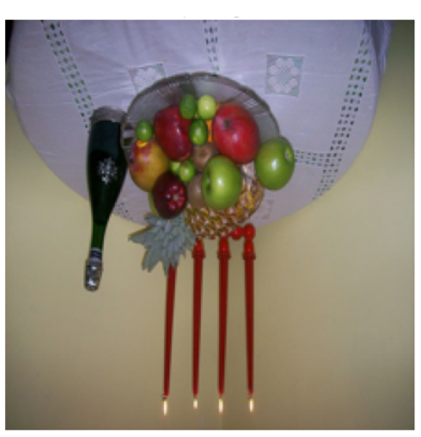
Data Preparation
Augmentation

Slide 12
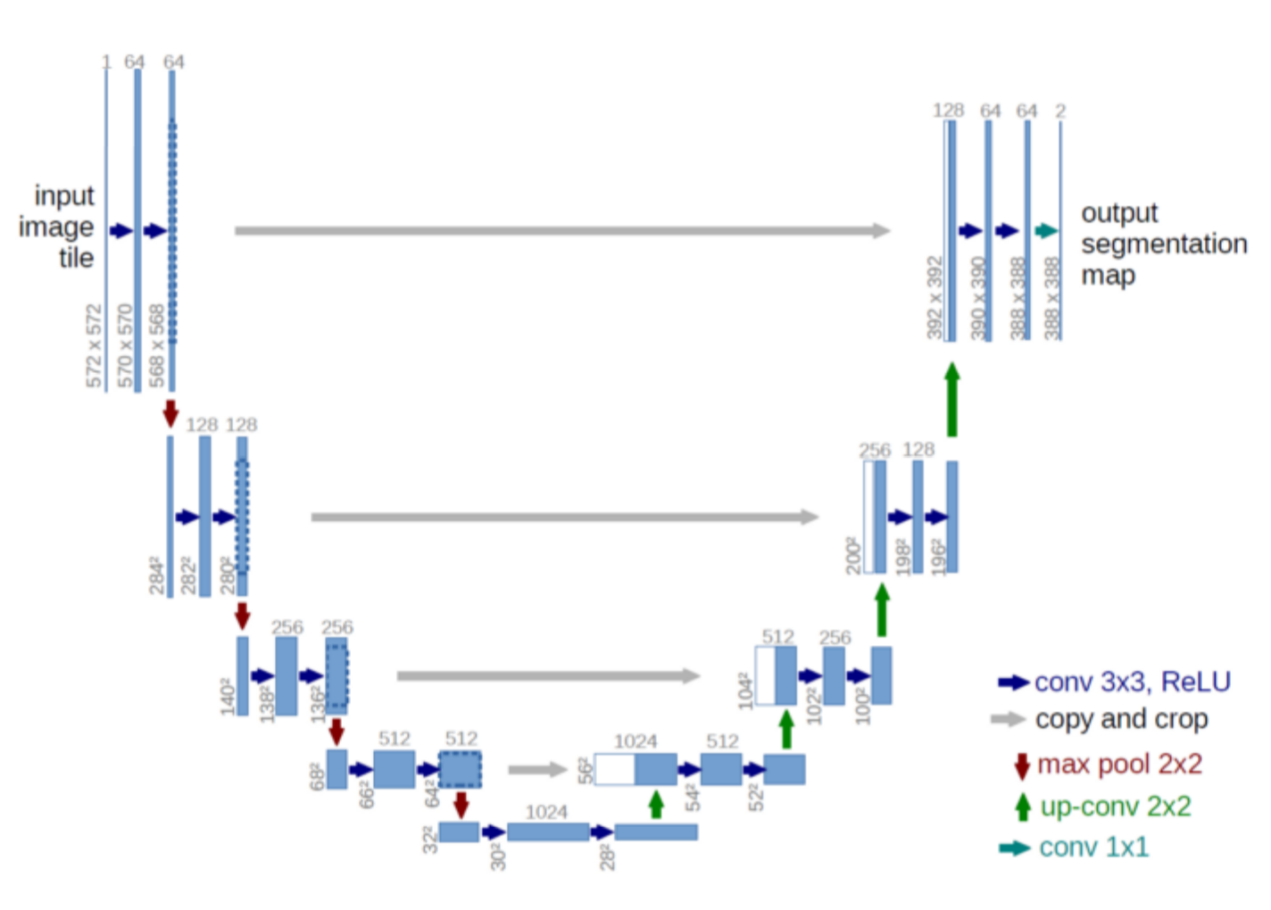
U-Net Model

Slide 13
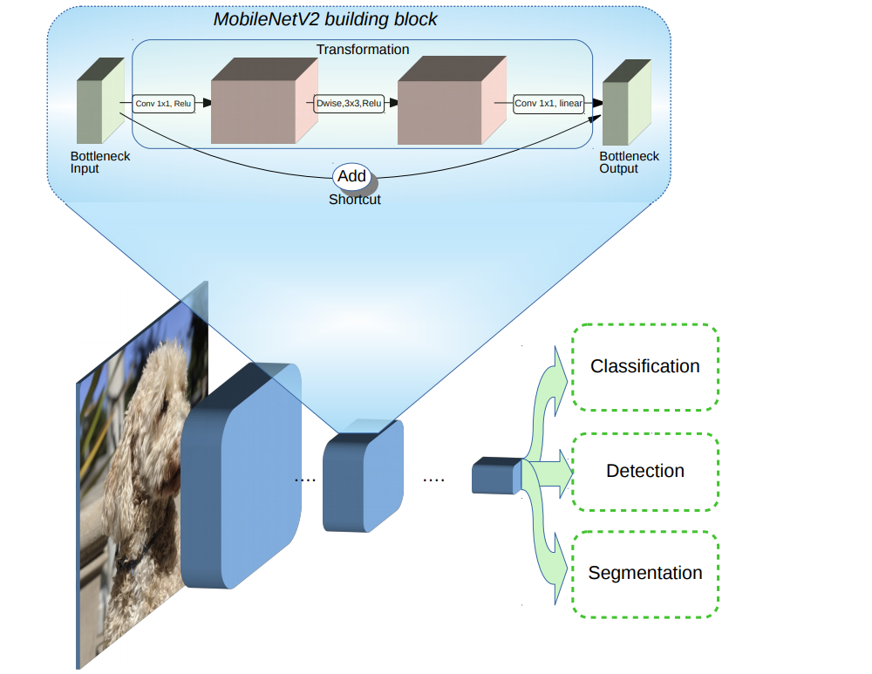
Encoder MobileNetV2
Decoder Pix2pix

Slide 14
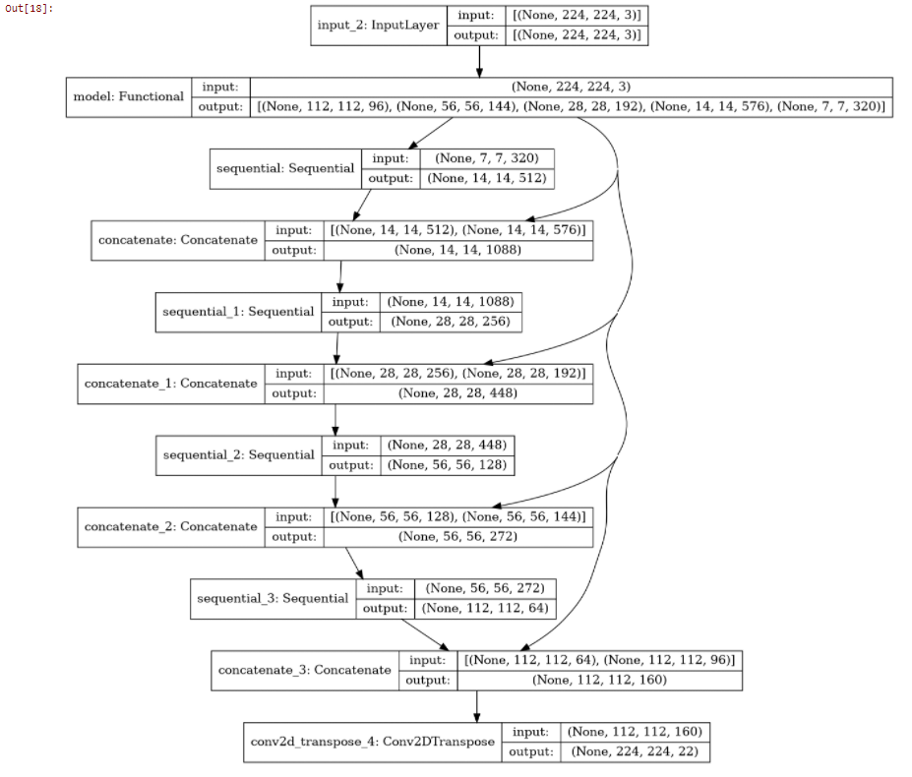
Model

Slide 15
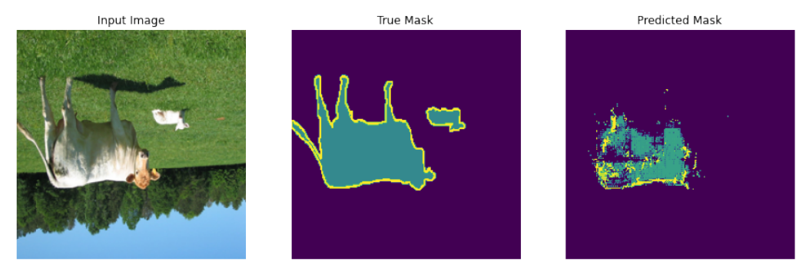
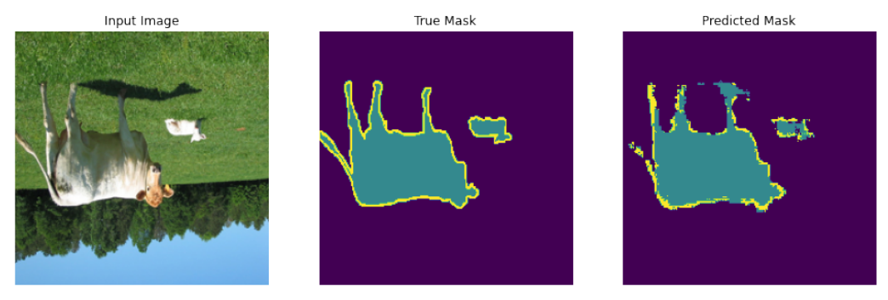
Training Progress
Epoch 1
Epoch 11

Slide 16
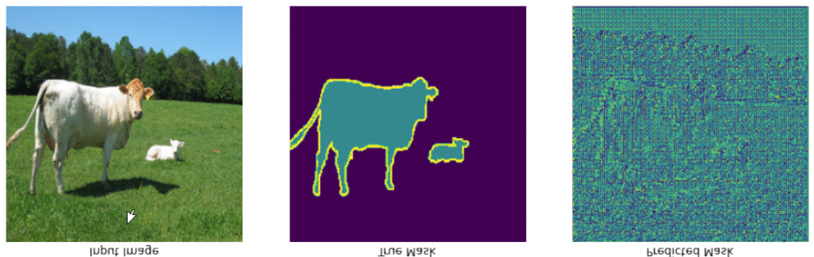
Model Training Progress

Slide 17
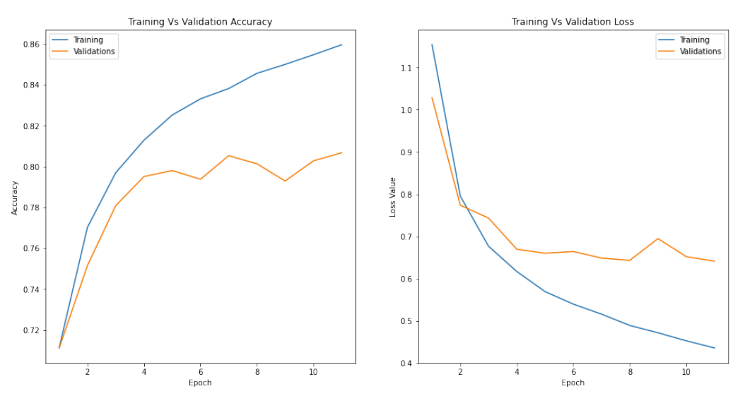
Learning Rate

Slide 18
Model Results
Dataset | Accuracy | Loss
Training | 85.96% | 0.43
Validation | 80.68% | 0.64
Test | 85.18% | 0.48

Slide 19
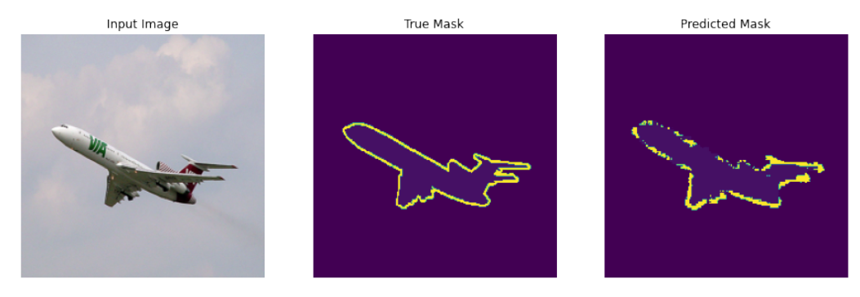
Sample Prediction

Slide 20
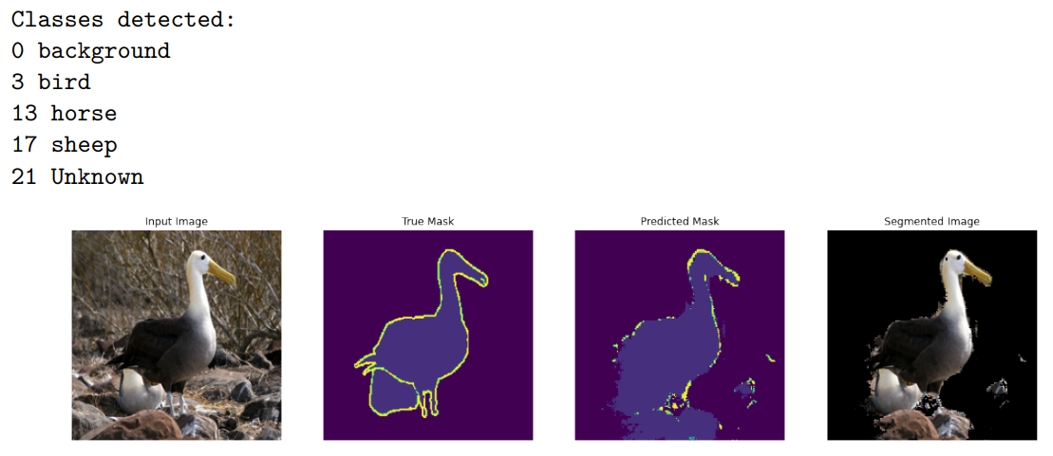
Model Predictions and segmentation

Slide 21
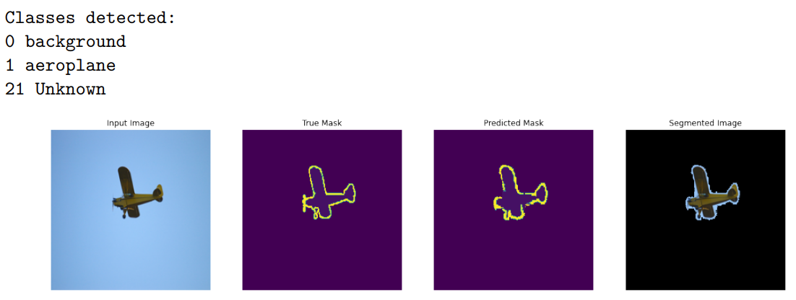
Model Predictions and segmentation

Slide 22
Thank You!

